Slide 1
PROKART
Guided By:
Prof. Nasim Shah (Guide and Project Co-Ordinator)
Team Members:
Aakanksha Padmanabhan 01
Radhika Choudhary 05
Inziya Dossa 11

Slide 2
Objective
To develop a online grocery portal
To enable the customer to easily buy grocery from the comfort of their homes
To gain huge exposure to buy grocery
Door to Door delivery of goods

Slide 3
Requirement Analysis
Software Requirements
Text Editor
Phpmyadmin
Web host
Domain
Programming Languages used
HTML5
CSS3
JavaScript
Bootstrap
Php

Slide 4
Design using CSS
Static HTML
HyperText Markup Language (HTML) is used for static front end of the website.
It is used to position the elements of the webpage and is widely used by all browsers for webpage markup.
Cascading Style Sheets (CSS) is used to set the styles in web pages containing HTML Elements.
The three types of CSS are:
Inline CSS
Embedded CSS
External CSS

Slide 5
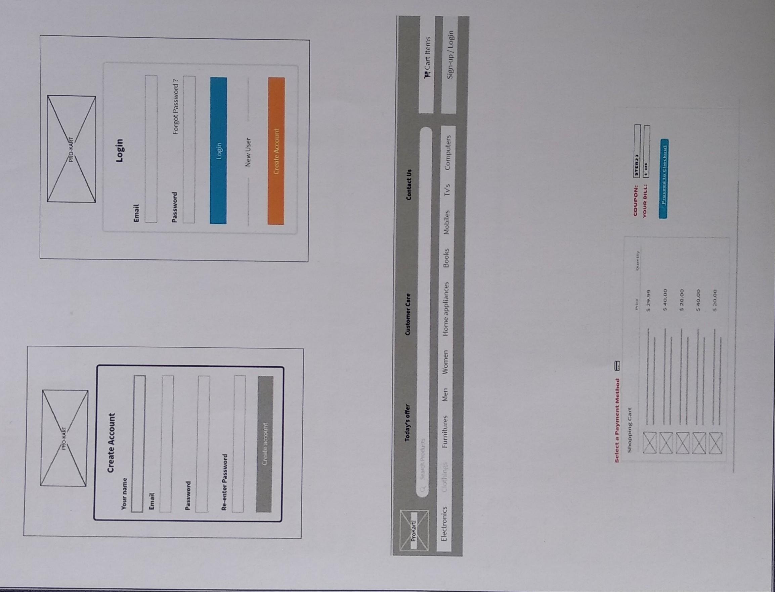
Skeleton for Website

Slide 6
RWD Framework
Web pages can be viewed using many different devices: desktops, tablets, and phones and should look good, and be easy to use, regardless of the device.
Web pages should not leave out information to fit smaller devices, but rather adapt its content to fit any device.

Slide 7
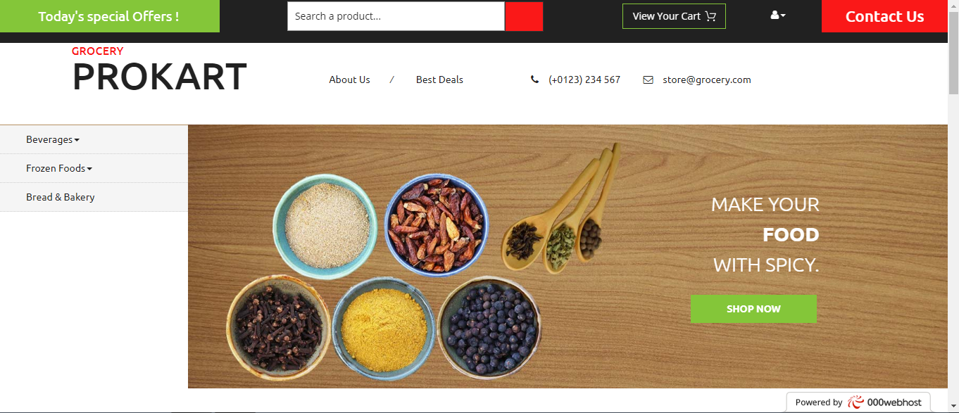
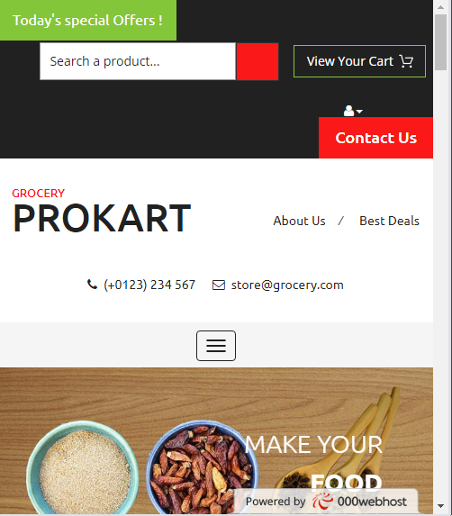
Responsiveness

Slide 8
Database : PHP
PHP, is used to connect to and manipulate databases.
MySQL is the most popular database system used with PHP.
We have used the MySqli Connect API to connect to the PhpMyadmin Database.

Slide 9
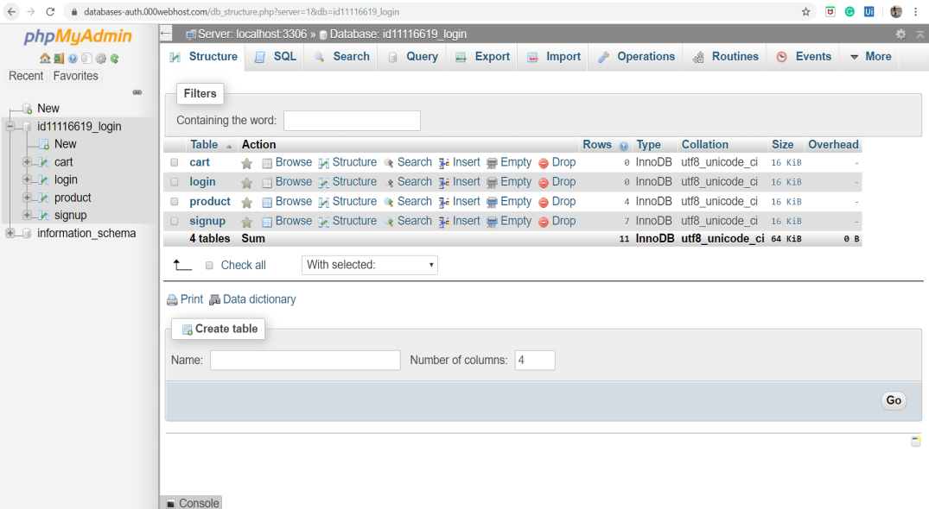
Create Database

Slide 10
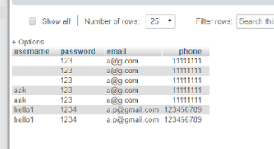
Connect Database

Slide 11
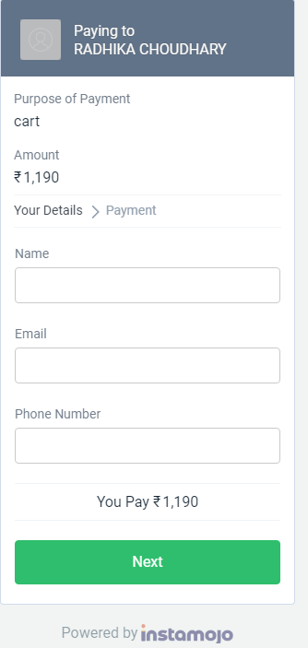
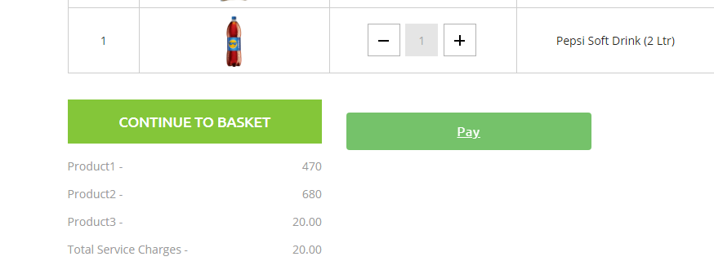
Web Service: Payment Gateway

Slide 12
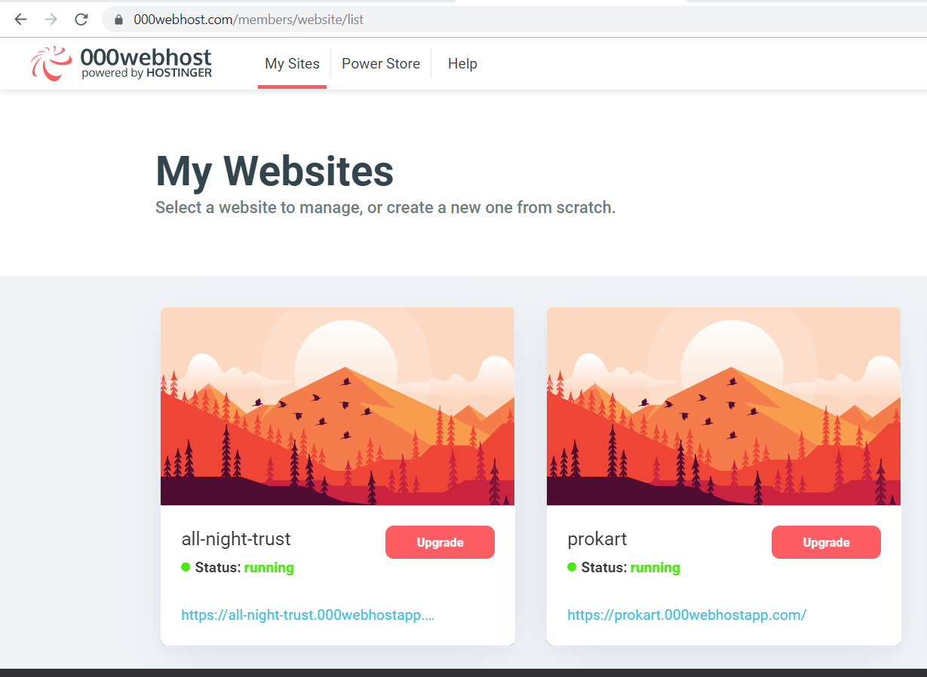
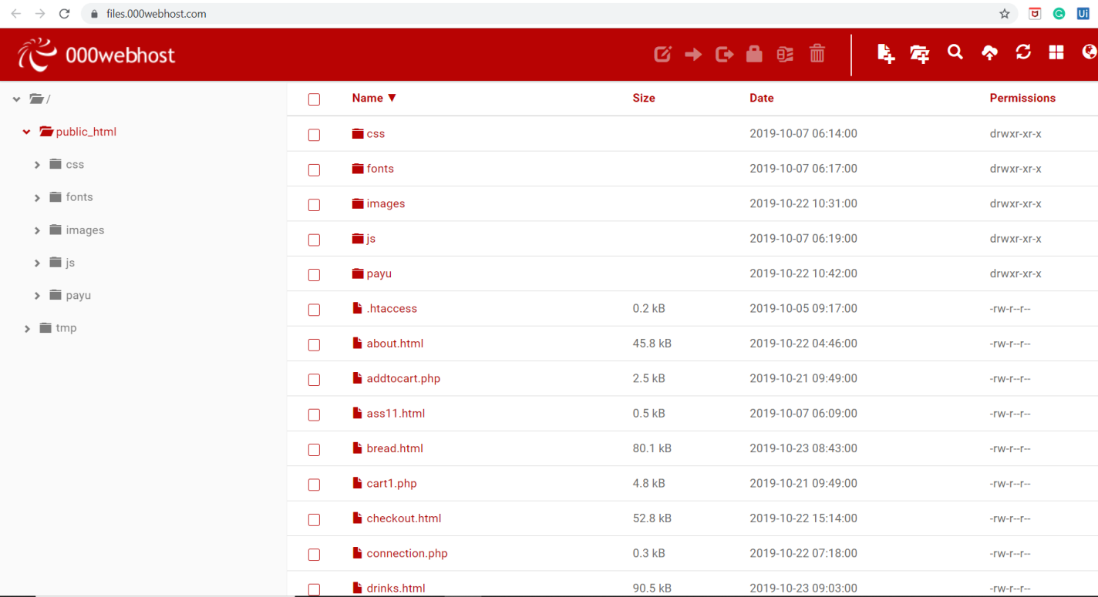
Hosting website: Webhostapp

Slide 13
Conclusion
Through this project we took a step towards to minimize the gap between the customer and the grocery store using a common interaction platform using PHP.
In this project we have tried to provide a hassle-free way of shopping for the consumers. The customers from the comfort of their home itself would be able to complete his shopping.
With the implementation of a payment gateway the customer is also provided with an option to complete their payment through internet.
Through this project we have tried to make the shopping experience of the customer hassle-free and provide the customer with an opportunity to enjoy other leisure activities

